Slide 1
Safety Monitoring System for the Elderly
AME494 Programming for lOT
Weichao Liang

Slide 2
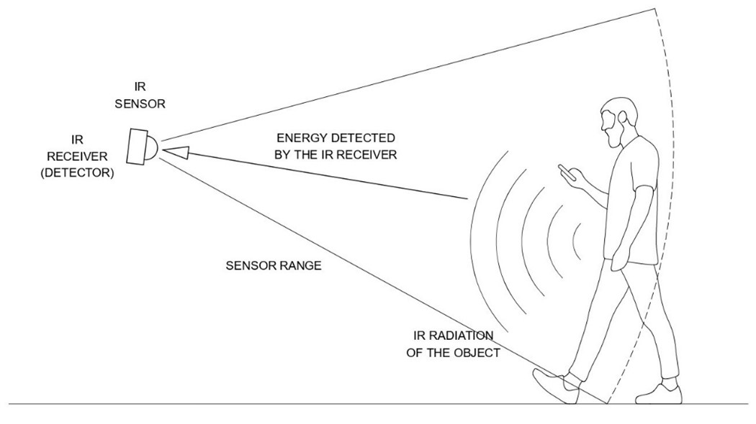
Installation of "Internet of Things infrared sensors" in the living rooms of the homes of the elderly living alone, which will automatically trigger a text message notification when the elderly living alone have not been active in the living room for 24 hours.
Infrared Sensor
Arduino
AWS

Slide 3
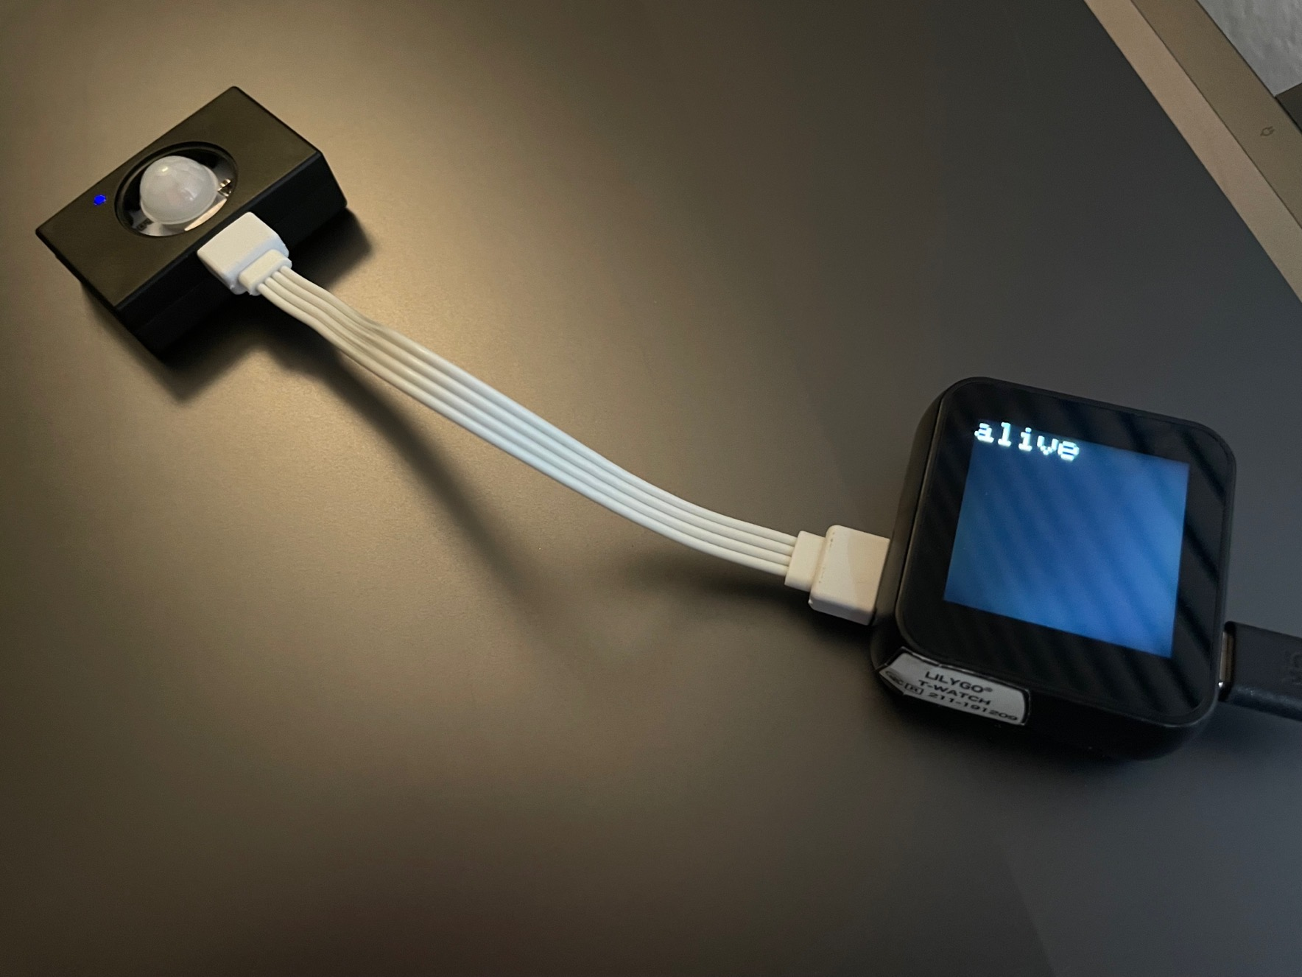
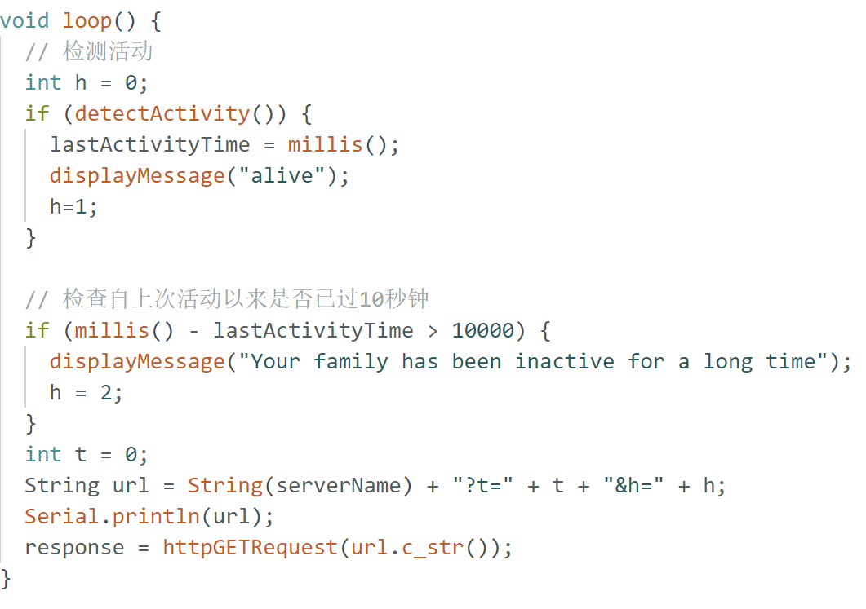
Control infrared sensors
Main loop, constantly checking for activity (via PIR sensor).
If activity is detected, the lastActivityTime is updated and the message "alive" is displayed on the watch.
If more than 10 seconds have passed since the last activity, a message is displayed indicating that the family has been inactive for a long time.
Construct a URL containing the temperature and humidity (although both are set to 0 in this case) as well as the activity status and send it via an HTTP GET request.
Print the response from the server

Slide 4
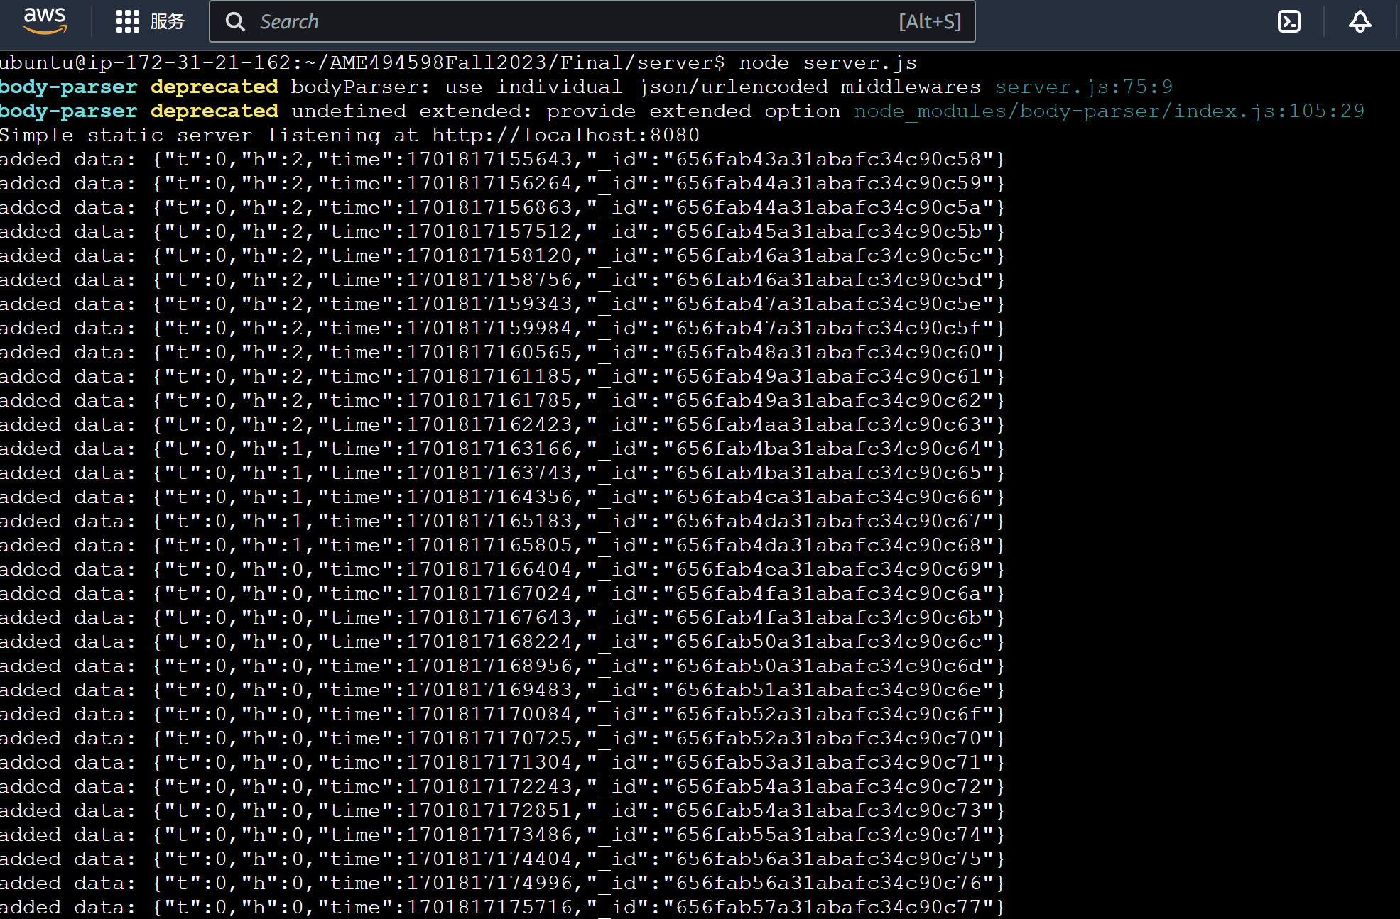
mC.ino acts as a client, sending sensor data to the cloud server, and server.js processes and stores the data. index.html, with the help of asyncReq.js, acts as a web page to display the data processed by server.js.

Slide 5



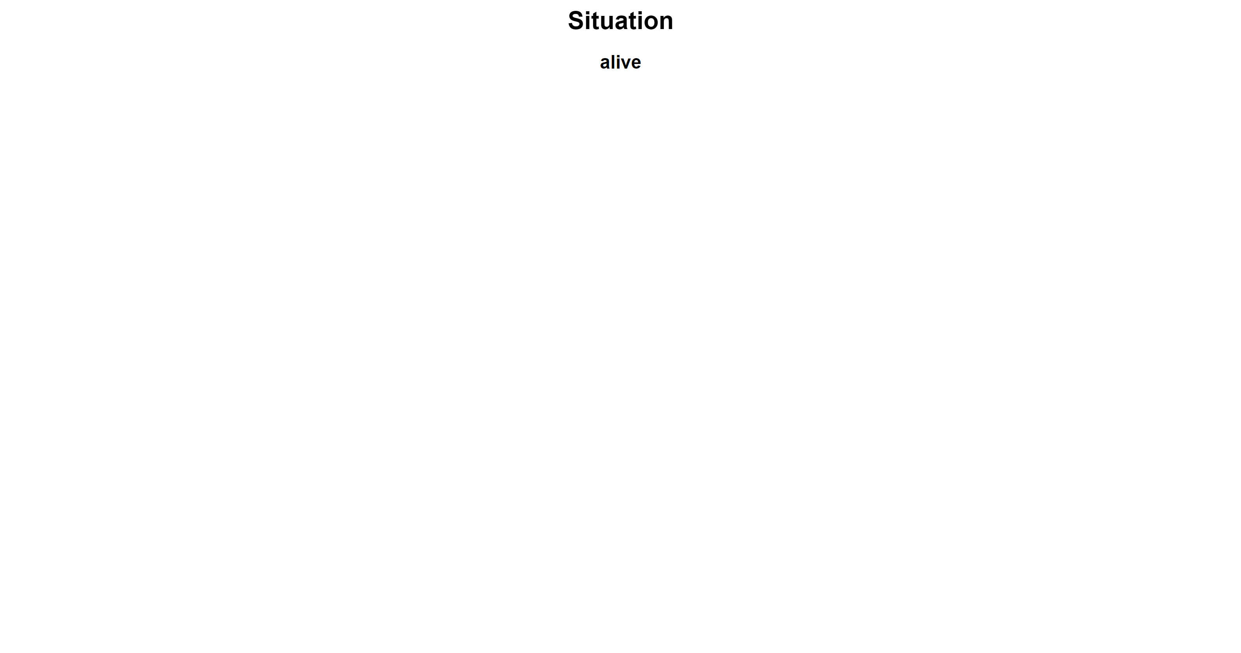
When the h output is 2.
When the h output is 1.

Slide 6
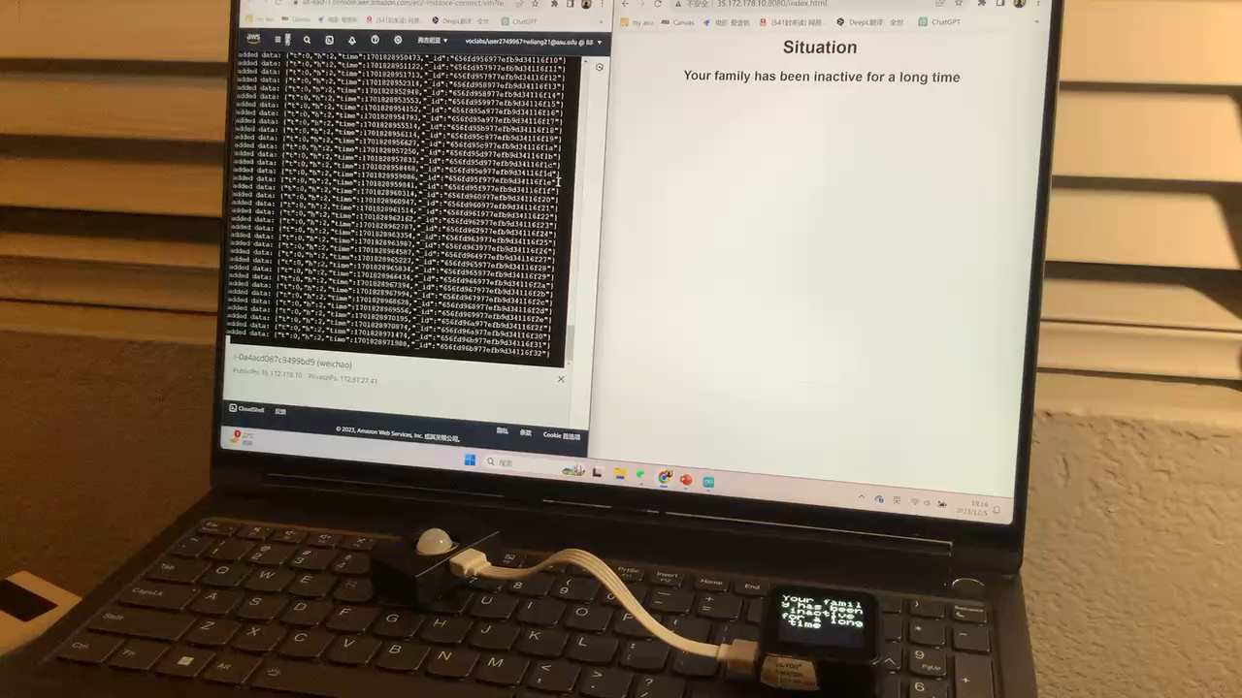
Interactive video

